Slide 1
Using GISMO-VI
Dos and Donts

Slide 2
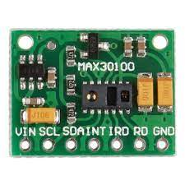
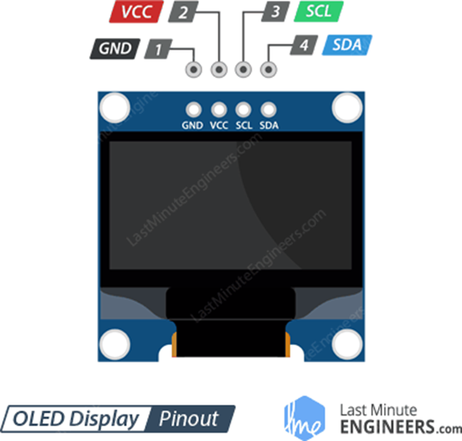
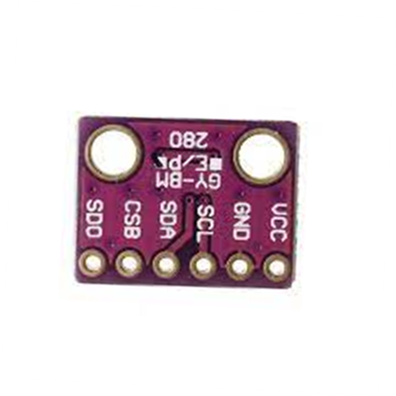
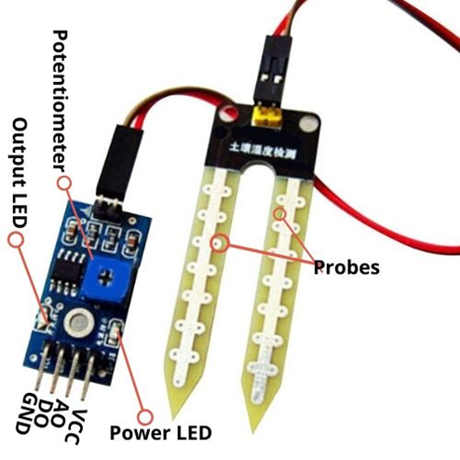
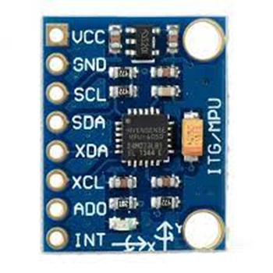
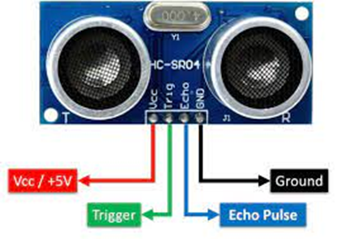
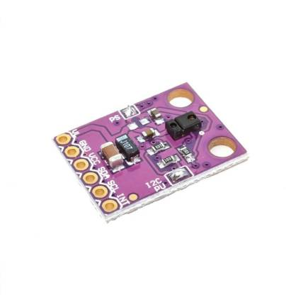
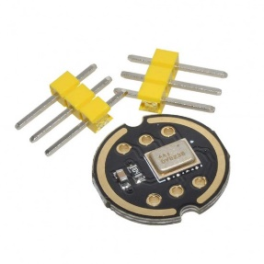
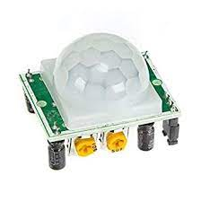
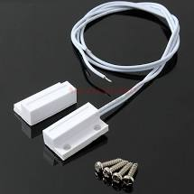
Know your sensors
Heart rate & Pulse Oximeter
OLED graphic display
BPM280 Environment sensor
MPU6050 3-axes accelerometer & gyro
HC-SR04 Ultrasonic sensor
Soil moisture sensor
APDS 9960 Gesture & Color sensor
Magnetic switch
INMP441 MEMS microphone
PIR sensor

Slide 3
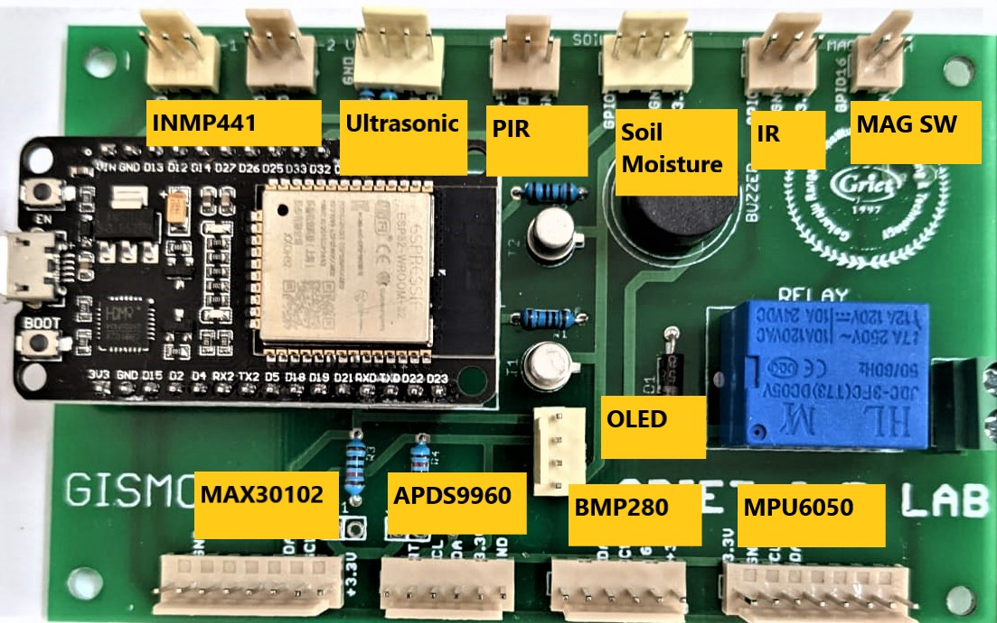
Know your sensor locations

Slide 4

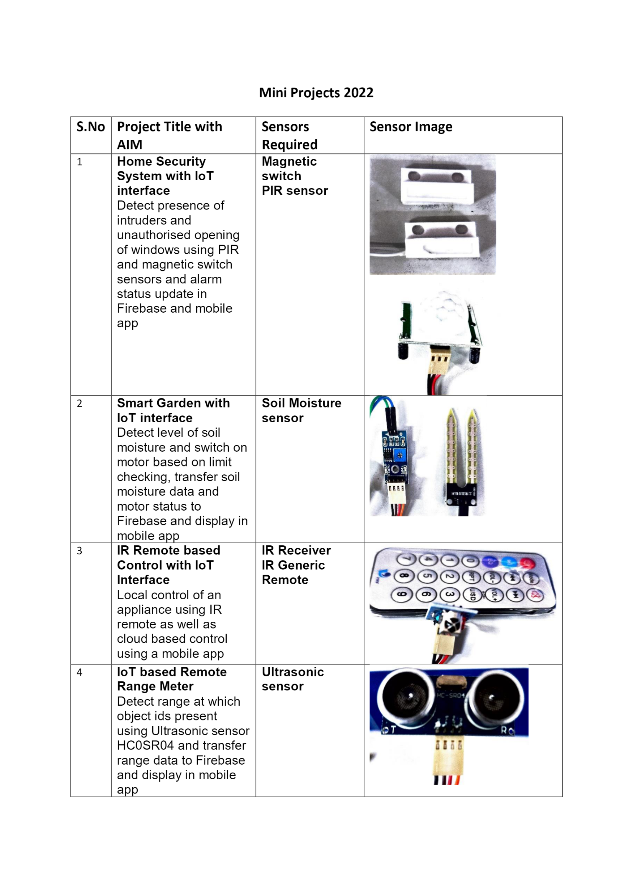
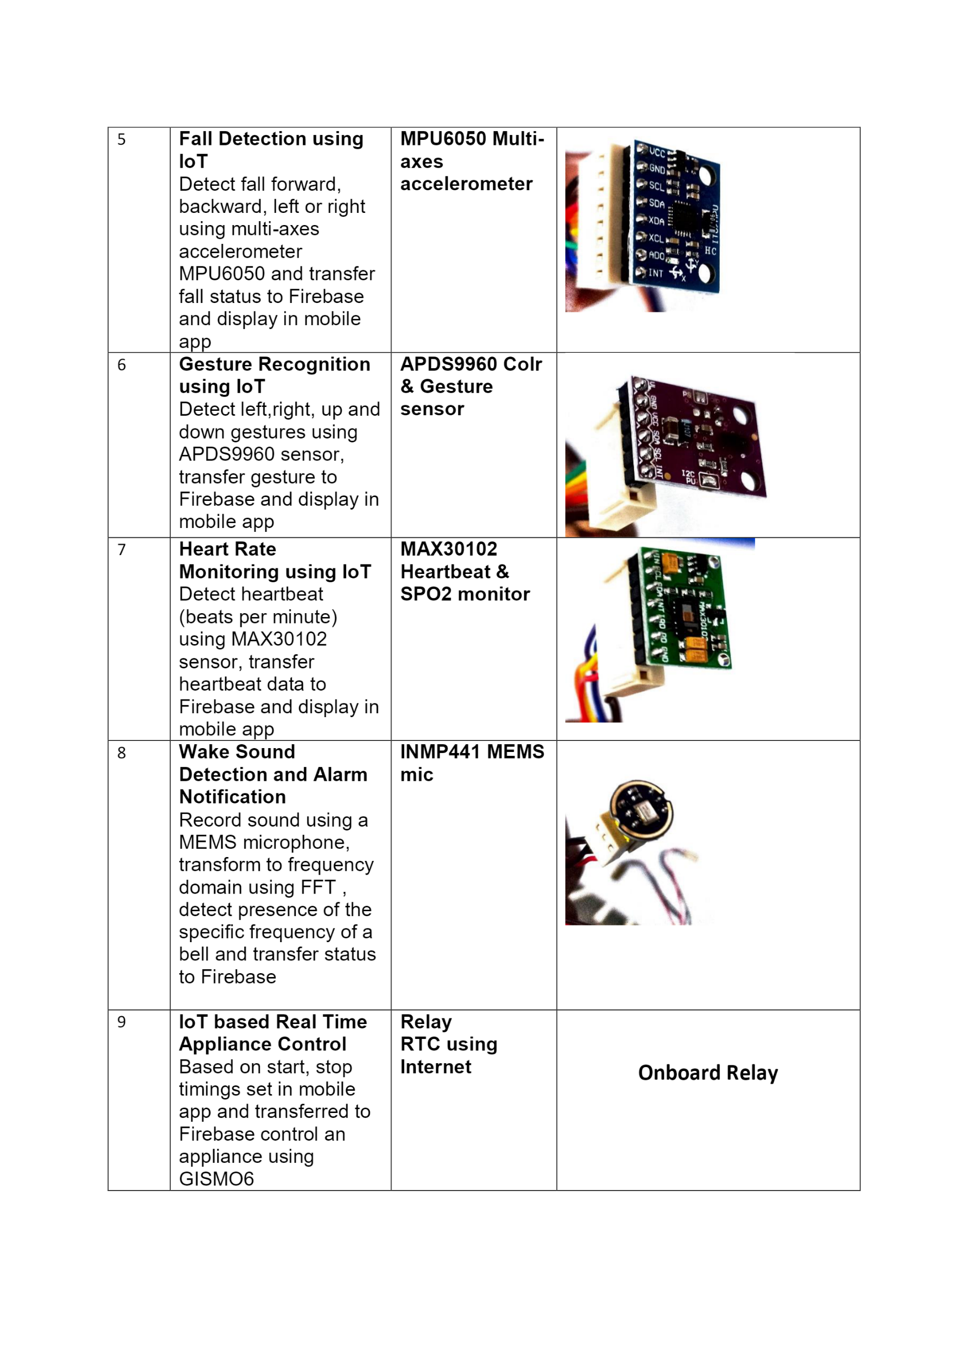
Do not disconnect the sensor from the cable

Slide 5
Connecting/disconnecting sensors
Power off the GISMO-VI when you want to connect or disconnect any sensor
To power off GISMO-VI, remove the USB cable from the laptop
Except for the OLED display, disconnect any sensor that you have finished working with

Slide 6
Install proper libraries
Consult the Arduino Libraries document in GISMO-VI repository of GitHub
Where the version is mentioned dinstall that version
For the BMP280 lirary, install all dependencies along with the library

